Slide 1
PC Repair Clinic Inventory System
Adam Stover
Steve Golden
Hannah Sartin

Slide 2
Our client
PC Repair Clinic on campus
Wants an updated inventory management system.

Slide 3
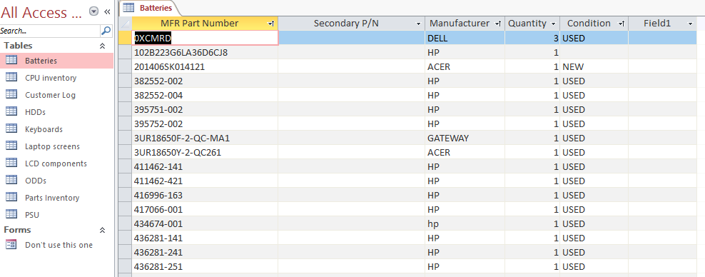
The Old System

Slide 4
The New System
Keep it similar to their current ticketing system.
Web based app.
Will be running on Ubuntu server.
Will be utilized on both FireFox and Chrome.

Slide 5
Scope
In Scope:
Barcode generation
Web-based app
Creation of MySQL database
Admin login page
Barcode scanners
Out of Scope:
Invoicing
QR Codes and scanners
Data load/conversion

Slide 6
Approach
HTML, CSS, JavaScript, PHP and MySQL.
MySQL v 5.5.59
JavaScript barcode generator
http://lindell.me/JsBarcode/
Materialize CSS
http://materializecss.com/
Working on an Ubuntu server (14.04.3 LTS)
Barcode scanners

Slide 7
Roles
Adam – Database Management
Steve – PHP/Backend
Hannah – Frontend and Design

Slide 8
Teamwork
Collaborating via Zoom
Trello
Slack
Open lab in GRF

Slide 9
Questions and Answers

